Slide 1
FastPytch
Outbound intelligence you control.
Product of Solo Vault AI, Inc.
Notes:
FastPytch — Outbound Intelligence You Control

Slide 2
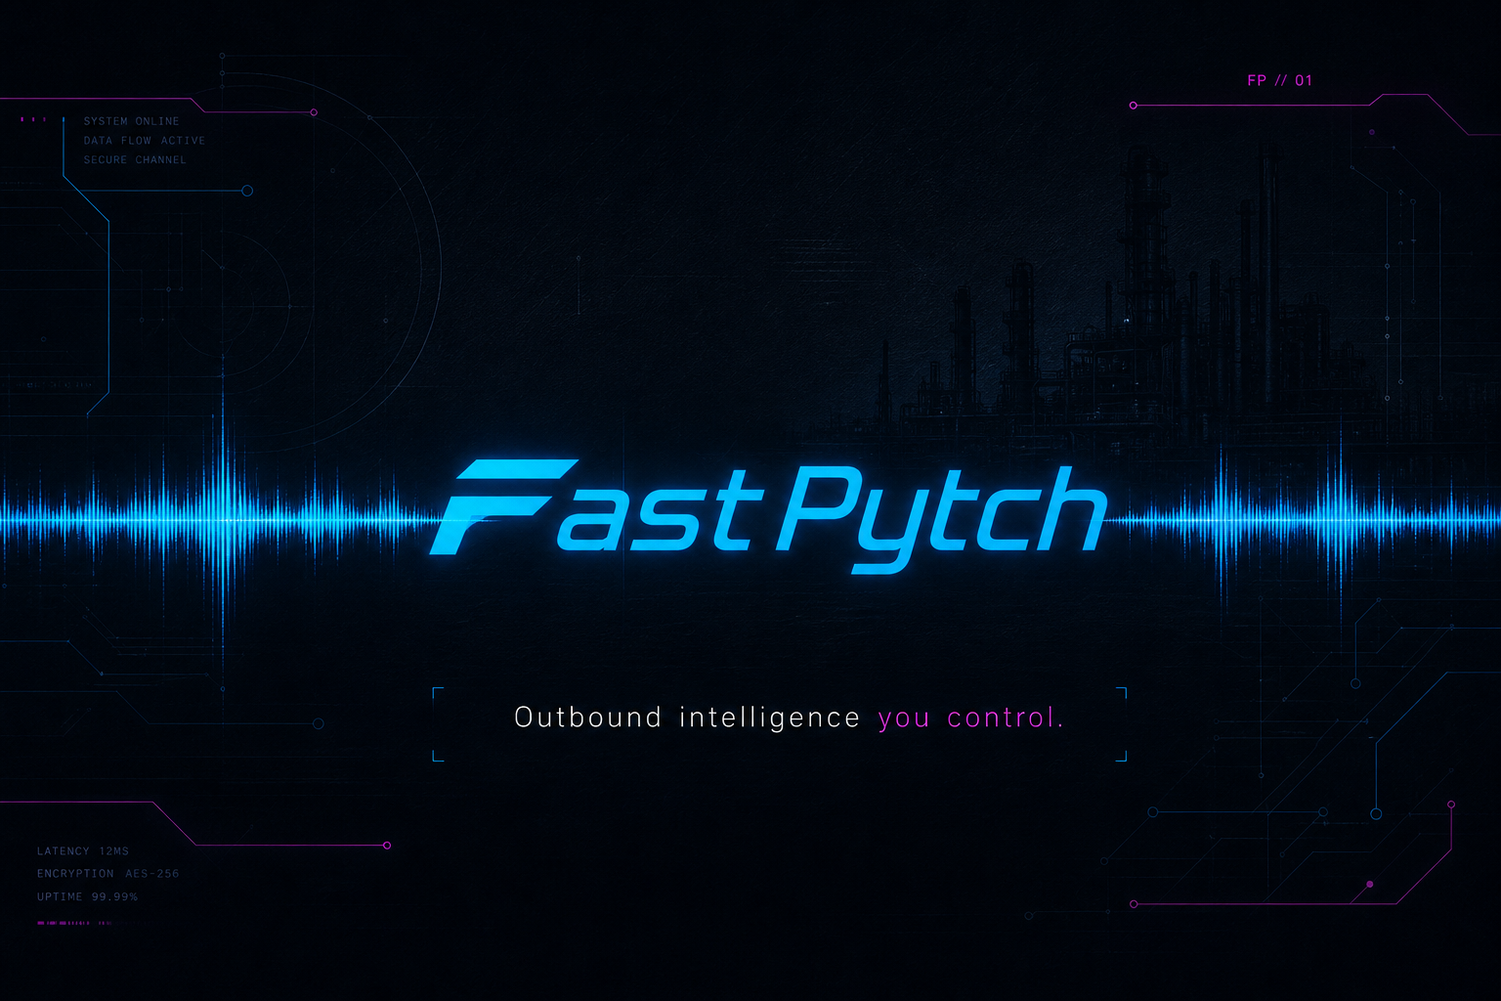
Notes:
On-screen: Outbound intelligence you control.
Voiceover:
You have alternative funds to place. Your team can only reach so many allocators in a day.

Slide 3
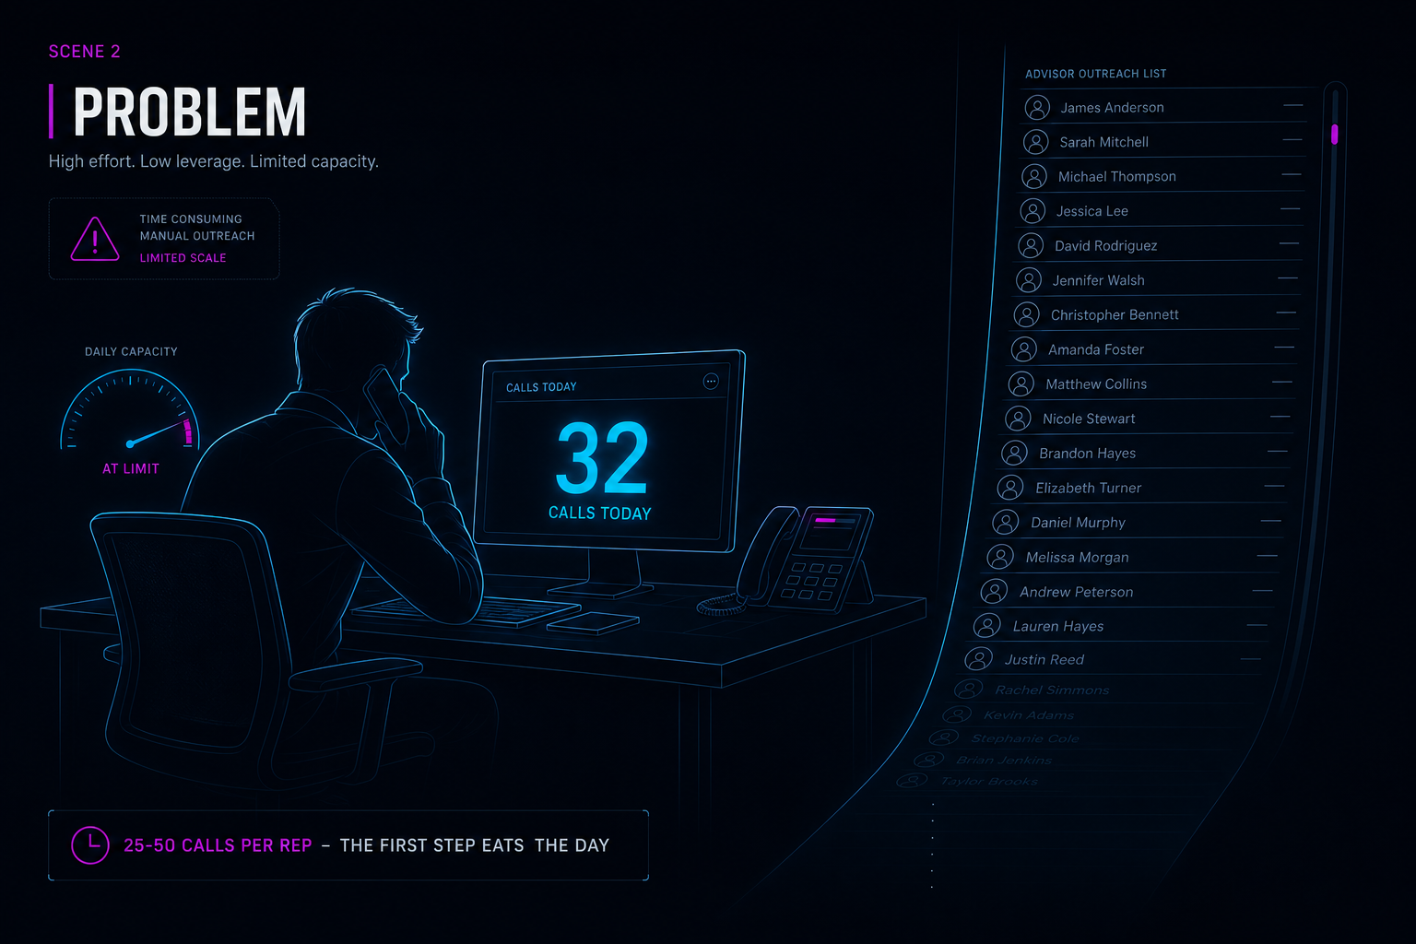
Notes:
On-screen: 25–50 calls per rep · The first step eats the day
Voiceover:
Even your best rep tops out at twenty-five to fifty dials. Outreach and scheduling consume the hours your closers should spend closing.

Slide 4
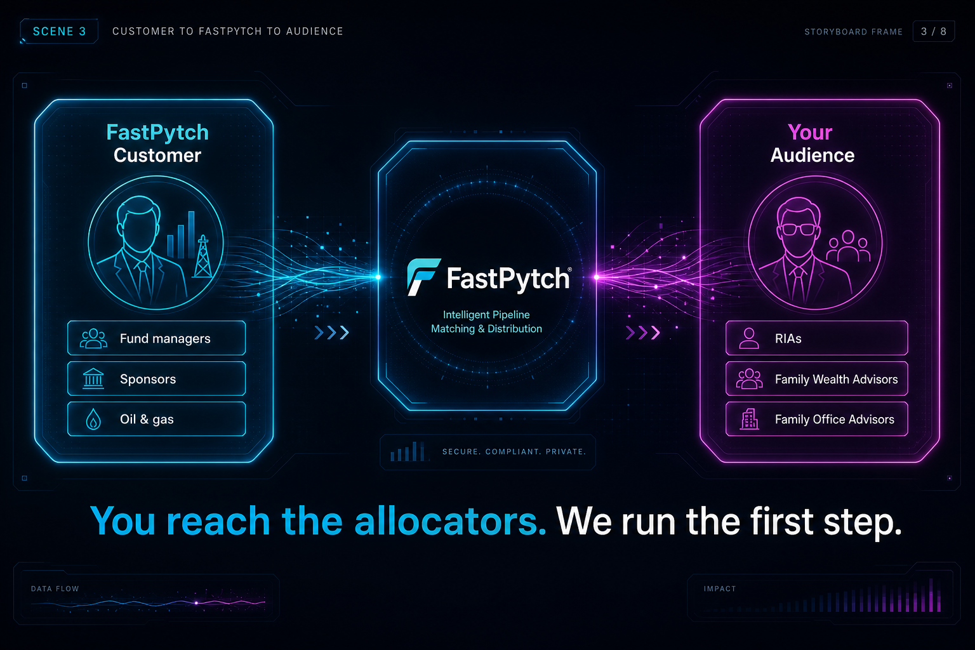
Notes:
On-screen: You reach the allocators. We run the first step.
Voiceover:
FastPytch serves fund managers and sponsors — our customers. You need to reach Registered Investment Advisors and Family Wealth Advisors — discerning allocators in alternatives. FastPytch runs that first step at the volume you choose.

Slide 5
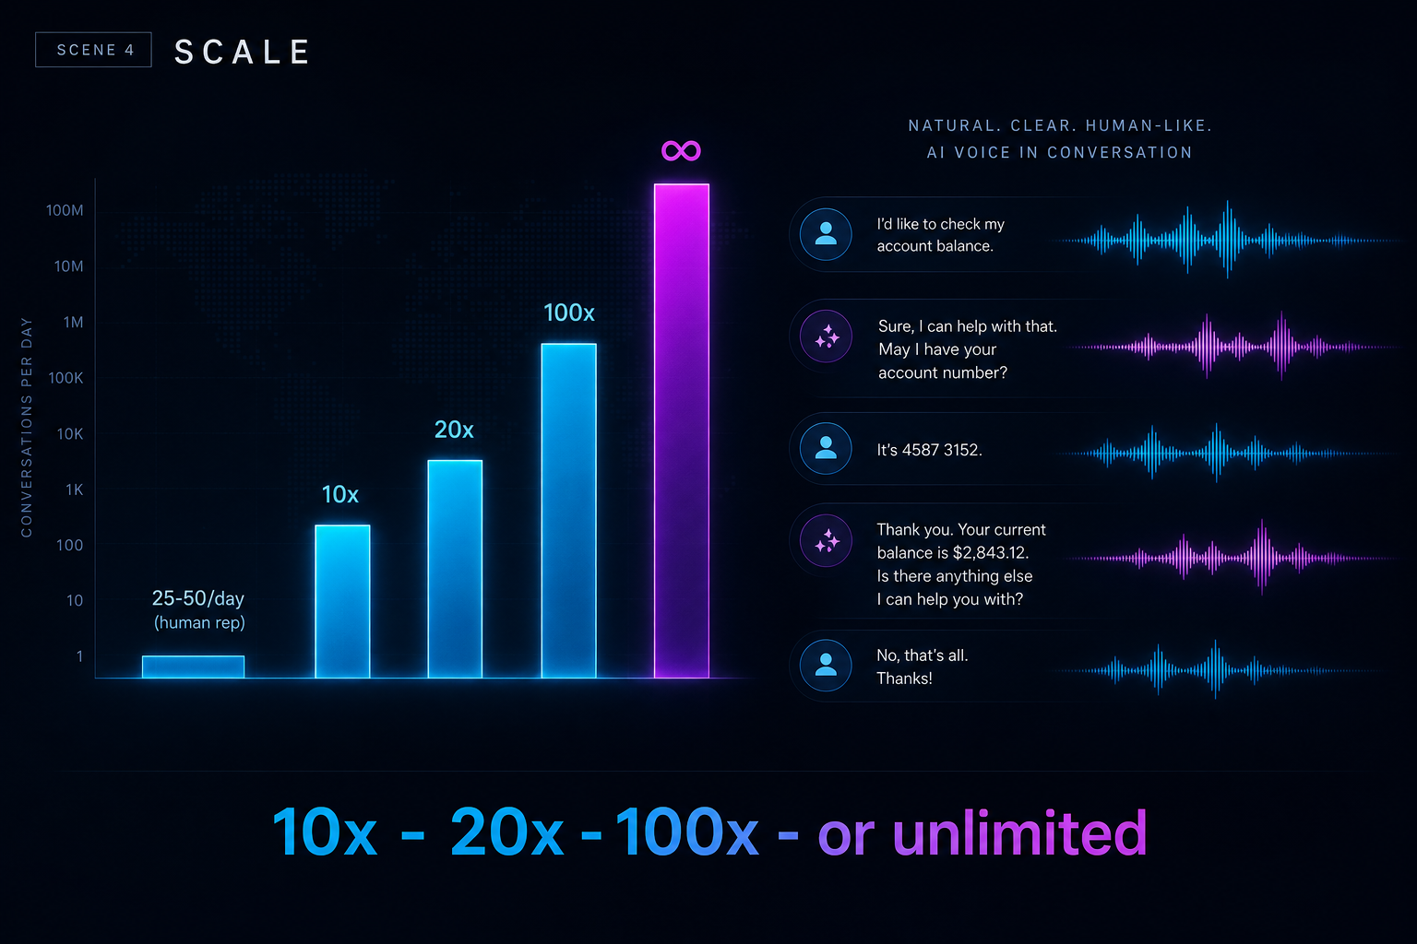
Notes:
On-screen: 10× · 20× · 100× — or unlimited
Voiceover:
AI voice agents place outbound calls, SMS, scheduling, and nurture — ten, twenty, a hundred times your reach, or unlimited. Your closers talk to interested allocators, not dial tone.

Slide 6
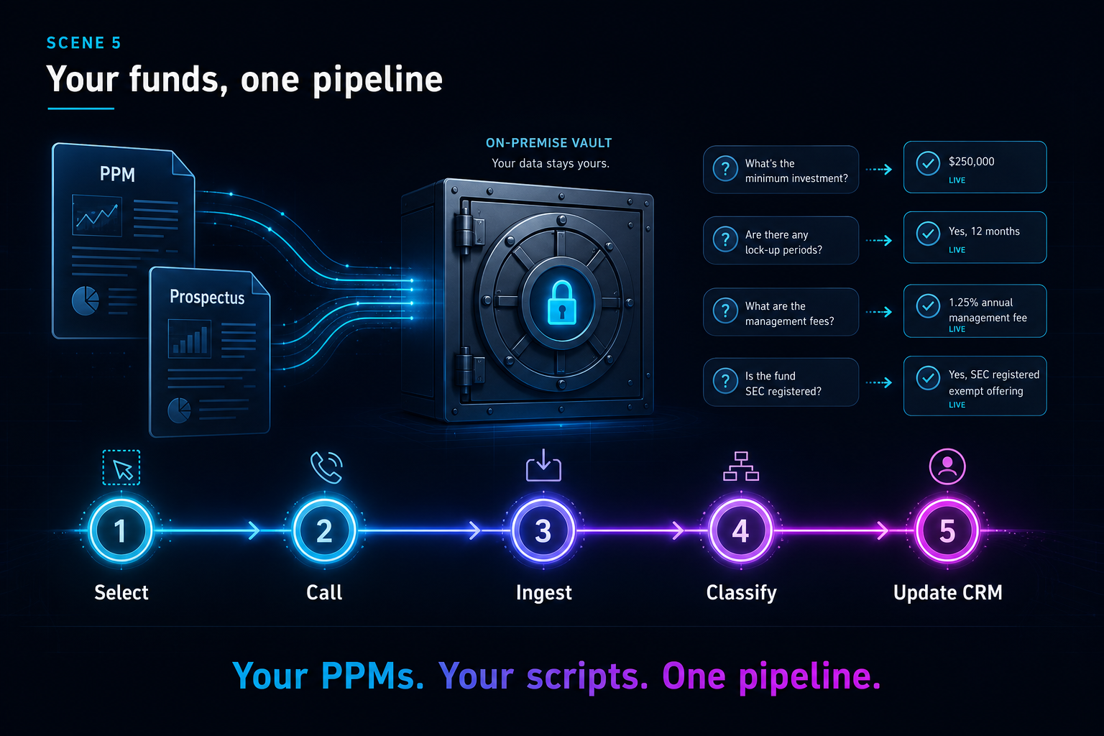
Notes:
On-screen: Your PPMs. Your scripts. One pipeline.
Voiceover:
Your prospectuses and fund materials feed a private knowledge base agents use live. Every contact moves from call to transcript to classified outcome to CRM update — automatically.

Slide 7
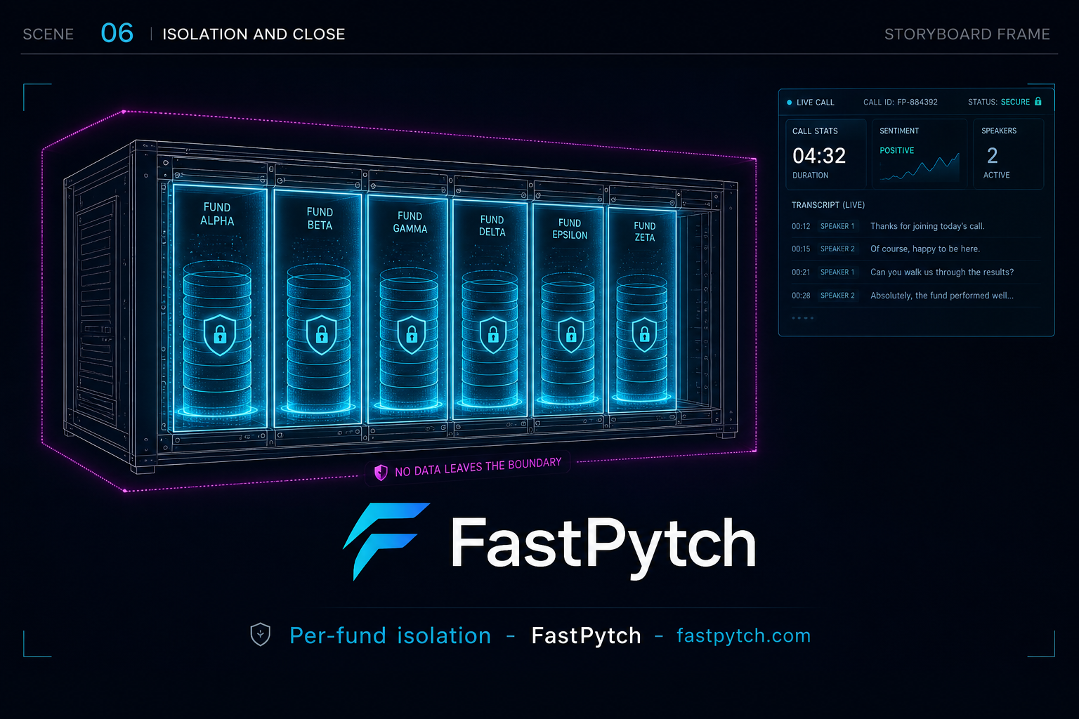
Notes:
On-screen: Per-fund isolation · FastPytch · fastpytch.com
Voiceover:
Each fund stays fully isolated on infrastructure you control. FastPytch — outbound intelligence you control.

Slide 8
FastPytch
fastpytch.com
FastPytch provides outbound infrastructure and workflow tooling. Customers remain responsible for regulatory compliance, appropriate consent and disclosure, and supervision of AI-generated communications in their jurisdiction.
Notes:
End card.

